Slide 1
IT&DATA VILLAGE IN WARSAW
CEE Summit-March 6th

Slide 2
Danone history
Notes:
Today 120+ Countries where Danone products are available around the globe.
96,000+ employees in over 55 countries.
Net sales reached €27,619m in 2023

Slide 3
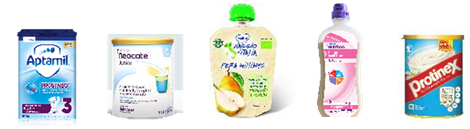
Our businesses
30%
54%
16%
SPECIALIZED NUTRITION
ESSENTIAL DAIRY AND PLANT-BASED
WATERS
Core milk
Specialise pediatrics
First diet
Adults
Healthy aging
Fresh dairy
Plant based
Prenium dairy
Coffee creamer
Plant based coffee
Waters
Aquadrinks
Notes:
#1 WORLDWIDE FOR FRESH DAIRY PRODUCTS
#1 WORLDWIDE FOR PLANT-BASED FOODS AND BEVERAGES
#2 WORLDWIDE FOR PACKAGED WATERS
#2 WORLDWIDE FOR EARLY-LIFE NUTRITION
#1 EUROPE FOR ADULT NUTRITION

Slide 4
The HOPE ValueS
H
O
P
E
HUMANISM
OPENNESS
PROXIMITY
ENTHUSIASM
At Danone, people are at the heart of everything we do.
We welcome new ideas from
the world we live in.
We believe that building close
relationships leads to better
understanding and trust.
We are passionate about bringing
health through food to as many
people as possible.
Responsibility
We believe that health, safety and well-being should always come first.
We depend on the planet, and we care for its future: sustainability is a priority for us, and a source of innovation.
Dialogue
Our hallmark in doing business is a continuous conversation with all stakeholders.
We collaborate with social representatives, seeking beneficial solutions for all.
Care
We only achieve big things when we care for each other, while keeping the bar high. We care for the communities in which we operate
We promote an informal management style, one where managers are open and remain close to their teams.
Energy
We play to win, finding joy in going the extra mile and achieving excellence.
We have an inner desire to overcome obstacles in order to achieve ambitious goals.
Authenticity
We operate in a transparent and honest way, always demonstrating the highest ethical standards and authentic leadership.
We have a strong reputation, trusted by millions of people who choose Danone to feed their families every day.
Curiosity
We are curious about the world, being open to new ideas.
We embrace change with a positive attitude, adapting proactively to new circumstances.
Closeness
We stay close to our customers, consumers and patients to fully understand and fulfill their needs.
Our brands and products are available everywhere, every day, for as many people as possible.
Passion
We are passionate about our distinctive culture, our superior brands and products, and our mission.
We are proud of our unique way of doing business where economic, social, and environmental goals are interdependent.
Trust
We create and set the conditions for people to feel comfortable to speak up and express their opinion.
We ensure any sensitive issues are communicated in an effective and transparent manner.
Empathy
We understand the importance of feelings human relationships, and the power of confidence in others.
We strive to build strong, high trust relationships based on active listening.
Respect
We celebrate the fact that each human being is unique and different.
We are committed to creating an inclusive and diverse workplace where each person can be themselves in order to grow and thrive.
Boldness
Our entrepreneurial spirit leads us to make bold decisions in the face of uncertainty.
We always look for agile and pragmatic solutions that help us grow and reach more people with our products.

Slide 5
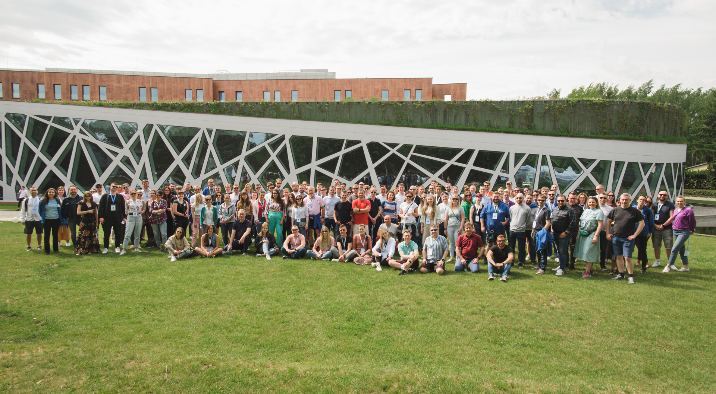
Welcome to the IT & Data Village

Slide 6
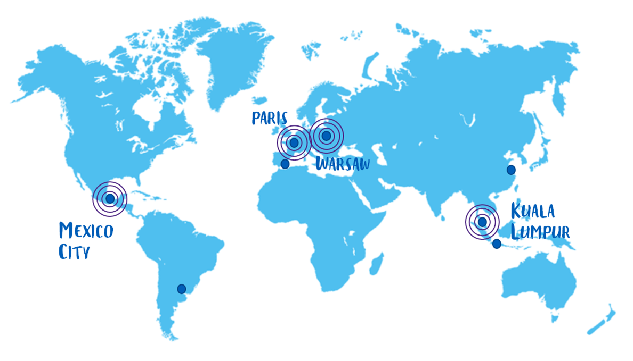
Our it&data villages

Slide 7
What is a village today?
One main location
Body of governance
2 teams
Leadership
Notes:
Emna Ideal village
2 teams: Applicable everywhere
One main location: Applicable everywhere
Leadership: Nuances: Some have a leader, Some have a couple of leaders, Some do not have (a) formal (s) leader(s)
Body of governance: Village Committee/Village Council/Fun Squad, Some have senior leaders only, Some have mix profiles, Some have 2 permanent members & the rest being rotative.

Slide 8
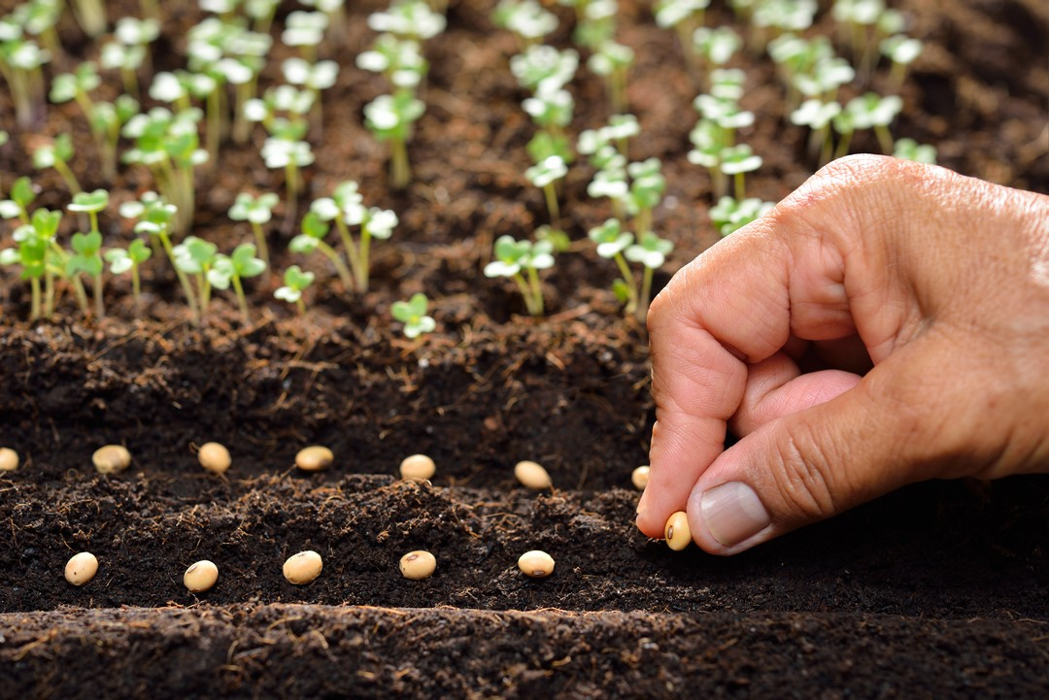
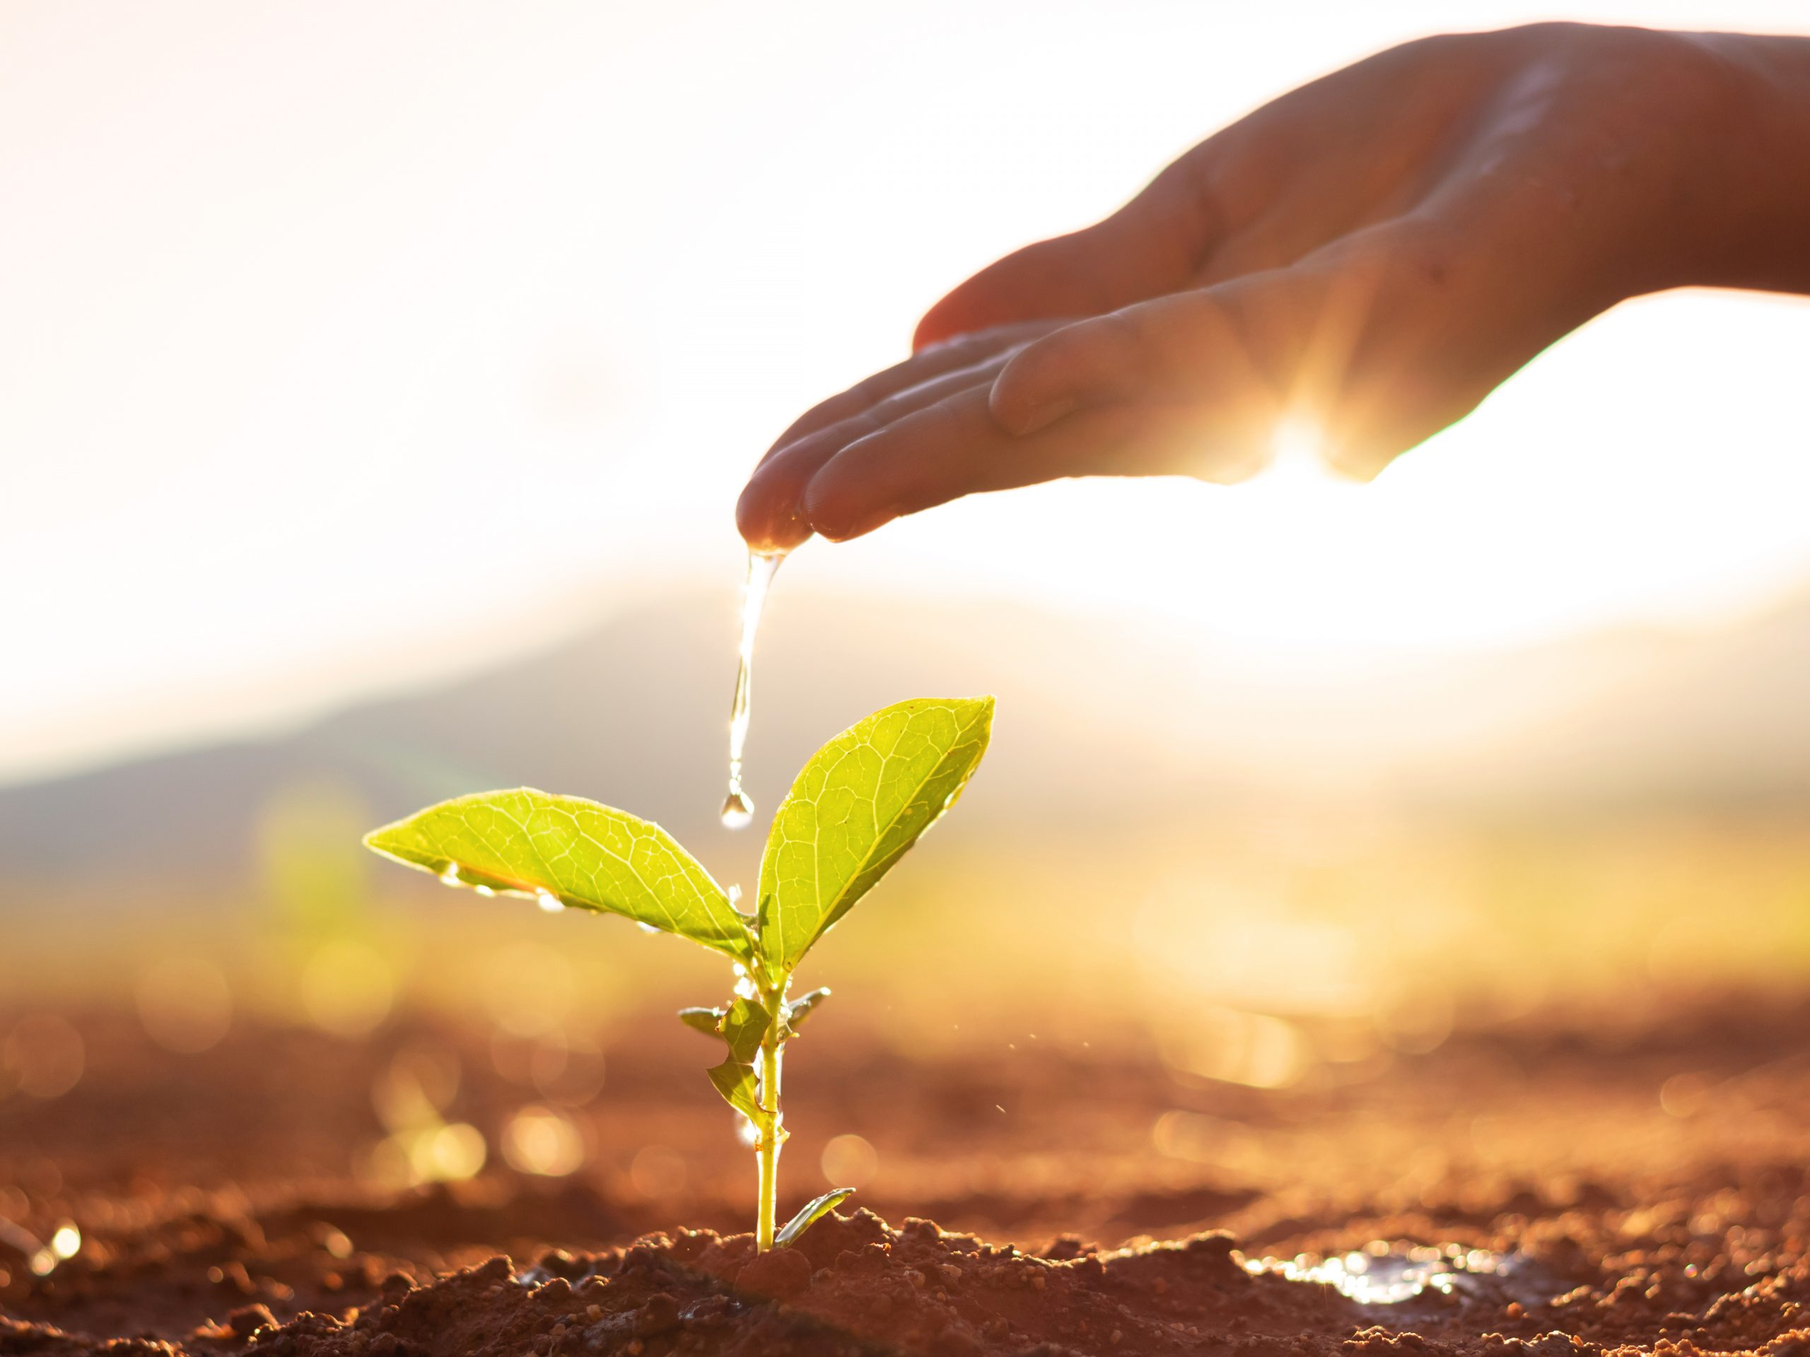
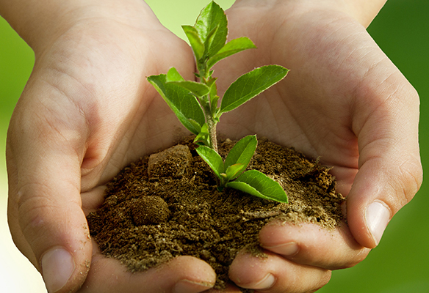
Village vision
We sow/plant
the seeds of the Village
We cultivate/nourish
the Village members
We develop a sustainable Village experience
We create routines
Get to regularly meet each other
Have fun together
We build One Team spirit
We come together as a community
We co-build
We develop a common sense of belonging
We build the foundations
Get to know each other
Listen to the people’s needs

Slide 9
From 2023
Create a common
sense of belonging
Make sure our talents
stay and grow
Attract more talents thanks to an important employer branding campaign

Slide 11
Thank you

