Slide 1
Tesco Business Solutions. Alex Laffan and Barbara Szigeti Nomination: Most Vibrant Employer - Hungary

Slide 2
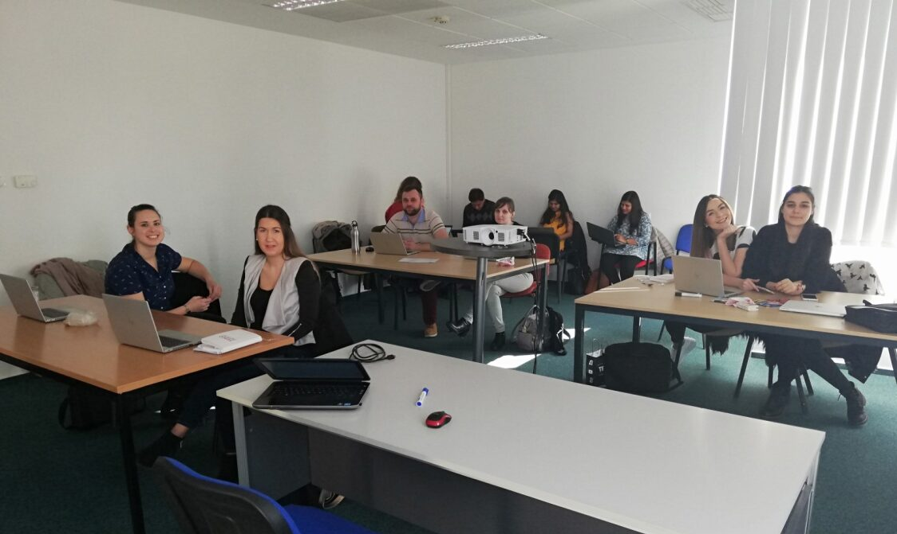
Where it all began: March 2019

Slide 3
Our Growth and Value Journey
Sign off
Wave 1 & hub start-up
Stabilise & transform
Wave 2
Value-add growth and maturity
Head-count
500
Covid-19 Pandemic
400
£23m value delivered
300
£11m value delivered
200
£5m value delivered
£3.5m value delivered
100
£1.4m value delivered
0
2018/19
2019/20
2020/21
2021/22
2022/23
2023/24

Slide 4
How did we deliver £20m+ value?
A Continuous Improvement Culture
World-Class Analytics Centre of Excellence
Exceptional integration to the core Tesco business

Slide 5
What makes us different?

Slide 6
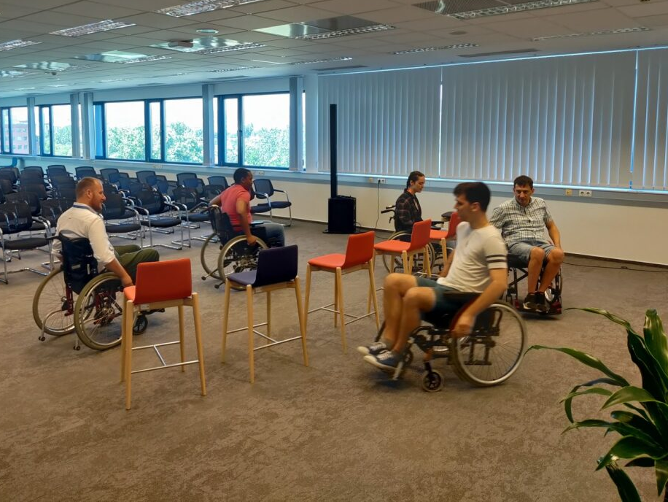
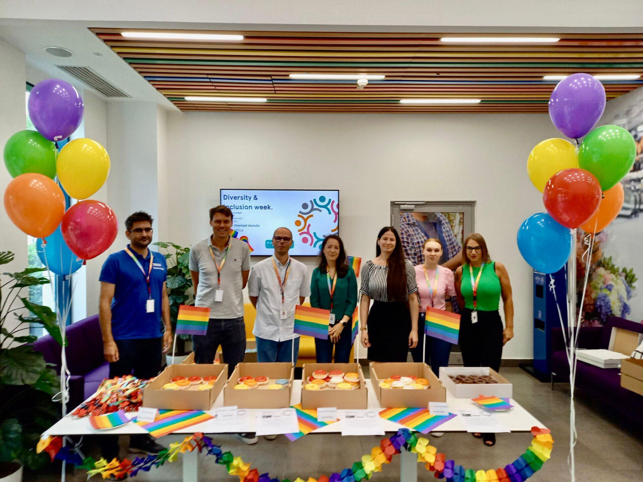
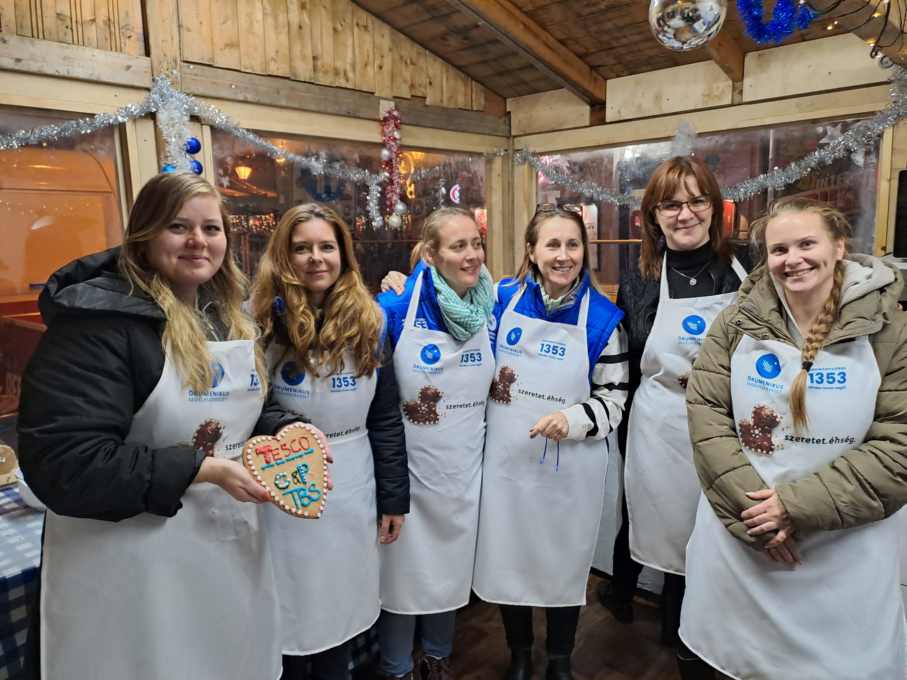
Our Success is Through our People
Our Tesco values:
We treat people how they want to be treated
Nobody tries harder for customers
Every little help makes a big difference
And our promise to our colleagues:
Everyone is welcome at Tesco
Your wellbeing first
We are a place to get on

